Slide 1
Lightweight Fault Tolerance in Pregel-Like Systems
Da Yan (UAB), James Cheng (CUHK), Hongzhi Chen (CUHK),
Cheng Long (NTU), Purushotham Bangalore (UAB)
Email: yanda@uab.edu

Slide 2
Overview
Google’s Pregel: A Review
Lightweight Checkpointing
Recovery by Vertex State Logging

Slide 3
Overview
Google’s Pregel: A Review
Lightweight Checkpointing
Recovery by Vertex State Logging

Slide 4
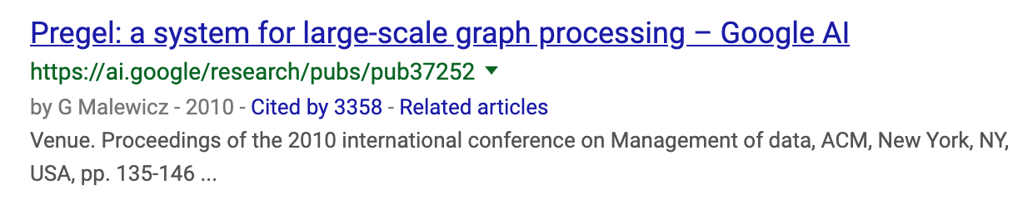
Google’s Pregel
Large-Scale Graph Processing
Think like a vertex
Message passing
Iterative
Each iteration is called a superstep

Slide 5
Google’s Pregel
Vertex Partitioning
1
2
4
5
6
0
3
7
8
0
1 | 3
1
0 | 2 | 3
2
1 | 3 | 4 | 7
3
0 | 1 | 2 | 7
4
2 | 5 | 7
5
4 | 6
6
5 | 8
7
2 | 3 | 4 | 8
8
6 | 7
M₀
M₁
M₂

Slide 6
Google’s Pregel
Programming Interfaces
u.compute(msgs)
u.send_msg(v, msg)
get_superstep_number()
u.vote_to_halt()
Called inside u.compute(msgs)

Slide 7
Google’s Pregel
Vertex state
Active / inactive
Reactivated by messages
Stop condition
All vertices are halted, and
No pending messages for the next superstep

Slide 8
Google’s Pregel
Hash-Min: Connected Components
v.compute(messages)
u₁
id₁
id₃
min
u₂
v
u₃
id
u₄
id₂
id₄

Slide 9
Google’s Pregel
Hash-Min: Connected Components
v.compute(messages)
If min < id:
u₁
min
u₂
min
min
v
min
min
u₃
id
=
u₄
Finally, vote to halt

Slide 10
Google’s Pregel
Hash-Min: Connected Components
3
13
3
13
1
11
1
11
7
5
0
6
8
17
15
10
10
16
18
7
5
0
6
8
17
15
10
16
18
2
12
2
12
4
14
4
14
Superstep 1

Slide 11
Google’s Pregel
Hash-Min: Connected Components
3
13
1
11
1
11
0
10
7
5
0
6
8
17
15
10
10
16
18
5
0
0
0
6
15
10
10
10
16
2
12
0
10
4
14
2
12
Superstep 2

Slide 12
Google’s Pregel
Hash-Min: Connected Components
3
13
0
10
1
11
0
10
7
5
0
6
8
17
15
10
10
16
18
0
0
0
0
0
10
10
10
10
10
2
12
0
10
4
14
0
10
Superstep 3

Slide 13
Google’s Pregel
Computing PageRanks
v.compute(messages)
u₁
0.5
w₁
1
u₂
v
w₂
1
1
3
summation
1
u₃
w₃
1.5
If superstep number limit reached, vote to halt directly

Slide 14
Google’s Pregel
Delete received neighbors
If v.degree < k
delete v
send “v” to neighbors
Vote to halt
Computing k-core
v.compute(messages)
k = 3

Slide 15
Google’s Pregel
Delete received neighbors
If v.degree < k
delete v
send “v” to neighbors
Vote to halt
Computing k-core
v.compute(messages)
k = 3

Slide 16
Google’s Pregel
Delete received neighbors
If v.degree < k
delete v
send “v” to neighbors
Vote to halt
Computing k-core
v.compute(messages)
k = 3

Slide 17
Overview
Google’s Pregel: A Review
Lightweight Checkpointing
Recovery by Vertex State Logging

Slide 18
Pregel’s Checkpointing
To periodically (e.g., every 10 supersteps) save the current state of computation as a checkpoint to a failure-resilient storage (e.g., HDFS)
During recovery, the latest checkpoint can be loaded to avoid re-computation from scratch
E.g., Failure at Superstep 97 => rerun from Superstep 90
Checkpointing reduces failure-free performance

Slide 19
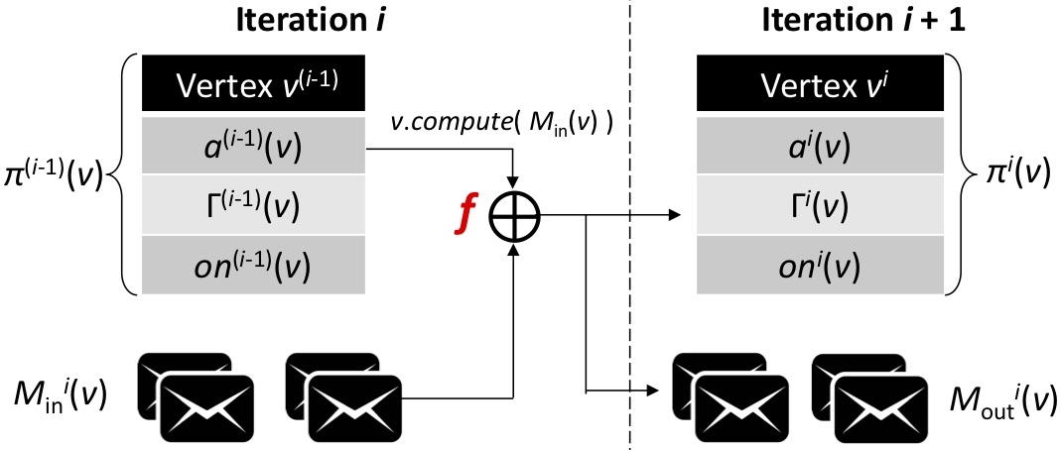
Pregel’s Checkpointing
A checkpoint is heavyweight, and saves
The states of all vertices
The edges (or, adjacency lists)
The incoming messages
Recall graph mutation in k-core
Input to v.compute(messages) for next iteration

Slide 20
Our Proposal
30 sec → 2 sec on WebUK
Lightweight Checkpointing (LWCP)
The states of all vertices
The edges (or, adjacency lists)
The incoming messages
How?
Incremental Edge Checkpointing
Every topology mutation is concurrently logged to local machine
Logs are committed to HDFS with each checkpoint
Old local logs are deleted after being committed
Recovery = load initial topology + replays the committed mutation logs

Slide 21
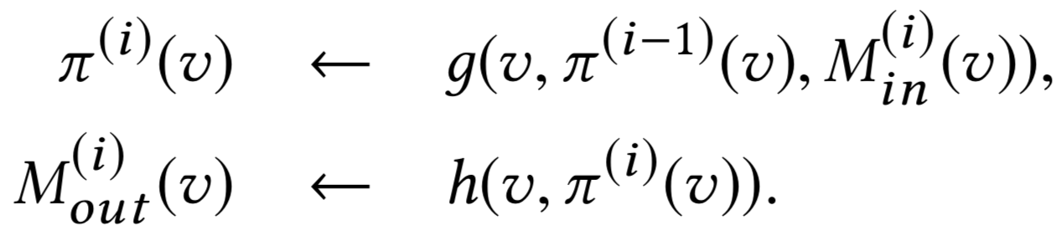
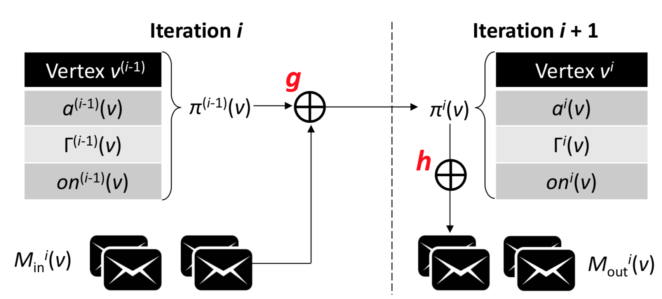
Our Proposal
30 sec → 2 sec on WebUK
Lightweight Checkpointing (LWCP)
The states of all vertices
The edges (or, adjacency lists)
The incoming messages
How?

Slide 22
Examples
May need additional vertex values maintained
Pagerank:
Send pagerank(v)/out-degree(v) to every out-neighbor
Hash-Min:
Maintain <smaller-id-received, min-id(v)>
If smaller-id-received = true, broadcast min-id(v) to neighbors
For k-core: <delete-tag(v), id(v)>

Slide 23
Illustration
Heavyweight Scheme
Compute & send messages
Superstep 1
Superstep 2
…
…
…
…
Superstep i
Superstep i + 1

Slide 24
Illustration
Heavyweight Scheme
Shuffling
Superstep 1
Superstep 2
…
…
…
…
Superstep i
Superstep i + 1

Slide 25
Illustration
Heavyweight Scheme
Compute & send messages
Superstep 1
Superstep 2
…
…
…
…
Superstep i
Superstep i + 1

Slide 26
Illustration
Heavyweight Scheme
Shuffling …
Superstep 1
Superstep 2
…
…
…
…
Superstep i
Superstep i + 1

Slide 27
Illustration
Heavyweight Scheme
Checkpointing
Superstep 1
Superstep 2
…
…
…
…
Superstep i
Superstep i + 1

Slide 28
Illustration
Heavyweight Scheme
Compute & send messages
Superstep 1
Superstep 2
…
…
…
…
Superstep i
Superstep i + 1

Slide 29
Illustration
Heavyweight Scheme
Shuffling
Superstep 1
Superstep 2
…
…
…
…
Superstep i
Superstep i + 1

Slide 30
Illustration
Heavyweight Scheme
Compute and crash
Superstep 1
Superstep 2
…
…
…
…
Superstep i
Superstep i + 1

Slide 31
Illustration
Heavyweight Scheme
Load Checkpoint
Superstep 1
Superstep 2
…
…
…
…
Superstep i
Superstep i + 1

Slide 32
Illustration
Heavyweight Scheme
Compute & send messages
Superstep 1
Superstep 2
…
…
…
…
Superstep i
Superstep i + 1

Slide 33
Illustration
Lightweight Scheme
Right before Superstep i
Superstep 1
Superstep 2
…
…
…
…
Superstep i
Superstep i + 1

Slide 34
Illustration
Lightweight Scheme
Checkpoint only vertex states
Superstep 1
Superstep 2
…
…
…
…
Superstep i
Superstep i + 1

Slide 35
Illustration
Lightweight Scheme
Compute & send messages
Superstep 1
Superstep 2
…
…
…
…
Superstep i
Superstep i + 1

Slide 36
Illustration
Lightweight Scheme
Shuffling
Superstep 1
Superstep 2
…
…
…
…
Superstep i
Superstep i + 1

Slide 37
Illustration
Lightweight Scheme
Compute and crash
Superstep 1
Superstep 2
…
…
…
…
Superstep i
Superstep i + 1

Slide 38
Illustration
The saved “active” status should be after the computation of Superstep i
Lightweight Scheme
Load Checkpoint
Superstep 1
Superstep 2
…
…
…
…
Superstep i
Superstep i + 1

Slide 39
Illustration
Generate messages from vertex states
Lightweight Scheme
Superstep 1
Superstep 2
…
…
…
…
Superstep i
Superstep i + 1

Slide 40
Implementation
Reuse v.compute(messages) for the 2-step logic, esp. the code for message generation from vertex states
During recovery, the states are the latest, so need to ignore the function calls that updates vertex states
Implemented in the system level

Slide 41
Overview
Google’s Pregel: A Review
Lightweight Checkpointing
Recovery by Vertex State Logging

Slide 42

Message Logging
To reduce recovery time by reducing the amount of communication during recovery
Every machine concurrently logs the messages generated by vertices to local disk(s)

Slide 43
Illustration
Message Logging
Compute & send messages
Superstep i
Superstep i + 2
Superstep i + 3
Superstep i + 4
Superstep i + 5

Slide 44
Illustration
Message Logging
Log messages
Superstep i
Superstep i + 2
Superstep i + 3
Superstep i + 4
Superstep i + 5

Slide 45
Illustration
Message Logging
Shuffling
Superstep i
Superstep i + 2
Superstep i + 3
Superstep i + 4
Superstep i + 5

Slide 46
Illustration
Message Logging
Checkpointing
Superstep i
Superstep i + 2
Superstep i + 3
Superstep i + 4
Superstep i + 5

Slide 47
Illustration
Message Logging
Compute, send & log messages
Superstep i
Superstep i + 2
Superstep i + 3
Superstep i + 4
Superstep i + 5

Slide 48
Illustration
Message Logging
Shuffling
Superstep i
Superstep i + 2
Superstep i + 3
Superstep i + 4
Superstep i + 5

Slide 49
Illustration
Message Logging
Compute, send & log messages
Superstep i
Superstep i + 2
Superstep i + 3
Superstep i + 4
Superstep i + 5

Slide 50
Illustration
Message Logging
Shuffling
Superstep i
Superstep i + 2
Superstep i + 3
Superstep i + 4
Superstep i + 5

Slide 51
Illustration
Message Logging
Compute, send & log messages
Superstep i
Superstep i + 2
Superstep i + 3
Superstep i + 4
Superstep i + 5

Slide 52
Illustration
Message Logging
Shuffling, compute and crash
Superstep i
Superstep i + 2
Superstep i + 3
Superstep i + 4
Superstep i + 5

Slide 53
Illustration
Only respawned worker(s) loads checkpoint
Message Logging
Superstep i
Superstep i + 2
Superstep i + 3
Superstep i + 4
Superstep i + 5

Slide 54
Illustration
Only respawned worker(s) computes
and writes message logs
Message Logging
Superstep i
Superstep i + 2
Superstep i + 3
Superstep i + 4
Superstep i + 5

Slide 55
Illustration
Only respawned worker(s) computes
Shuffling
Surviving workers get messages from logs
Message Logging
Only send those msgs to respawned worker(s)
Superstep i
Superstep i + 2
Superstep i + 3
Superstep i + 4
Superstep i + 5

Slide 56
Illustration
Only respawned worker(s) computes
Shuffling
Surviving workers get messages from logs
Message Logging
Only send those msgs to respawned worker(s)
Superstep i
Superstep i + 2
Superstep i + 3
Superstep i + 4
Superstep i + 5

Slide 57
Illustration
Only respawned worker(s) computes
Shuffling
Surviving workers get messages from logs
Message Logging
Send all msgs to all workers
Superstep i
Superstep i + 2
Superstep i + 3
Superstep i + 4
Superstep i + 5
Recovered

Slide 58
The Problem
Need to delete old logs after each checkpointing, to save space
Message Logging
Large logs → slower failure-free performance
Superstep i
Superstep i + 2
Superstep i + 3
Superstep i + 4
Superstep i + 5

Slide 59
Our Solution
Respawned worker generates msgs from checkpointed vertex states
Surviving workers generates msgs from logged vertex states
Vertex State Logging
Small logs ☺
Superstep i
Superstep i + 2
LWCP
Superstep i + 3
Superstep i + 4
Superstep i + 5

Slide 60
Our Solution
Shuffling
Only send those msgs to respawned worker(s)
Vertex State Logging
Small logs ☺
Superstep i
Superstep i + 2
LWCP
Superstep i + 3
Superstep i + 4
Superstep i + 5

Slide 61
Our Solution
Shuffling
Only send those msgs to respawned worker(s)
Vertex State Logging
Small logs ☺
Superstep i
Superstep i + 2
LWCP
Superstep i + 3
Superstep i + 4
Superstep i + 5

Slide 62
Our Solution
Vertex State Logging
The same API as LWCP
Negligible time for deleting vertex state logs
Recovery is 4x to 8x faster

Slide 63


Our Other Graph-Parallel Systems
Blogel [PVLDB’14]
Pregel+ [WWW’15]
Quegel [PVLDB’16]
GraphD [TPDS’18]
G-Miner [EuroSys’18]
G-thinker:

Slide 64
Thanks !
YAN, Da
Contact Info:
Email: yanda@uab.edu
Webpage: www.cs.uab.edu/yanda

